Slide 1
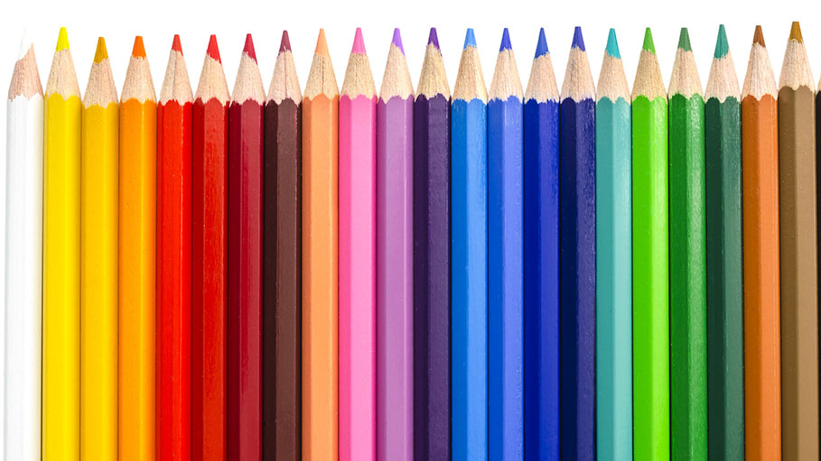
Color and Painting Assignment
By Quang Huynh

Slide 2
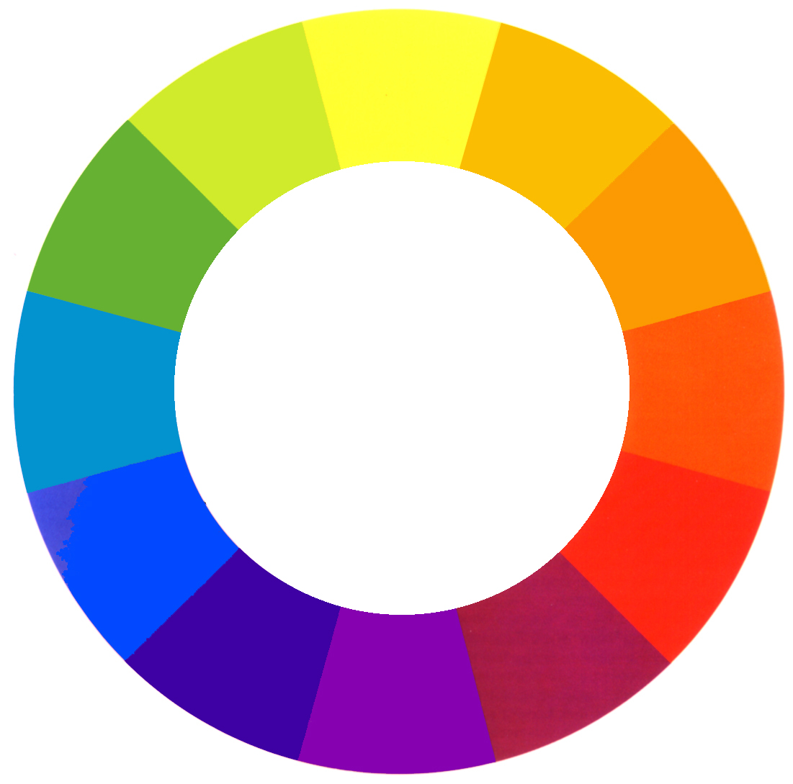
Hue
The name of a pure color.

Slide 3
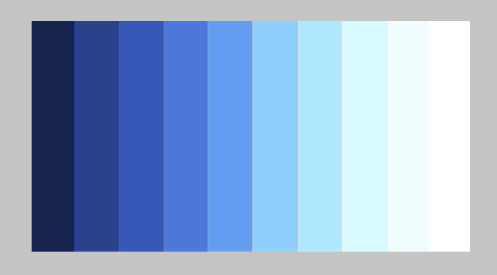
Value
The lightness or darkness of a color

Slide 4
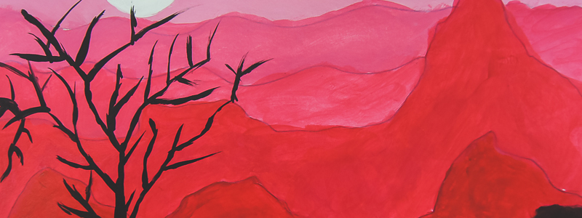
Tint
A color with white added to it.

Slide 5
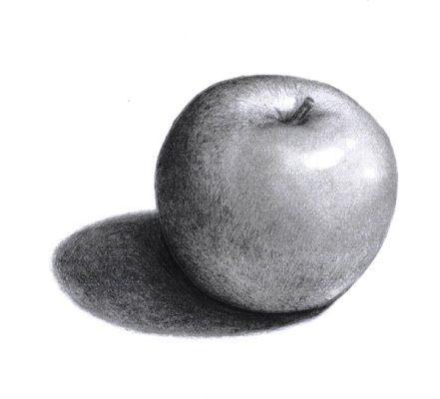
Shade
A color with black added to it.

Slide 6
Intensity
How bright or dull a color is.

Slide 7
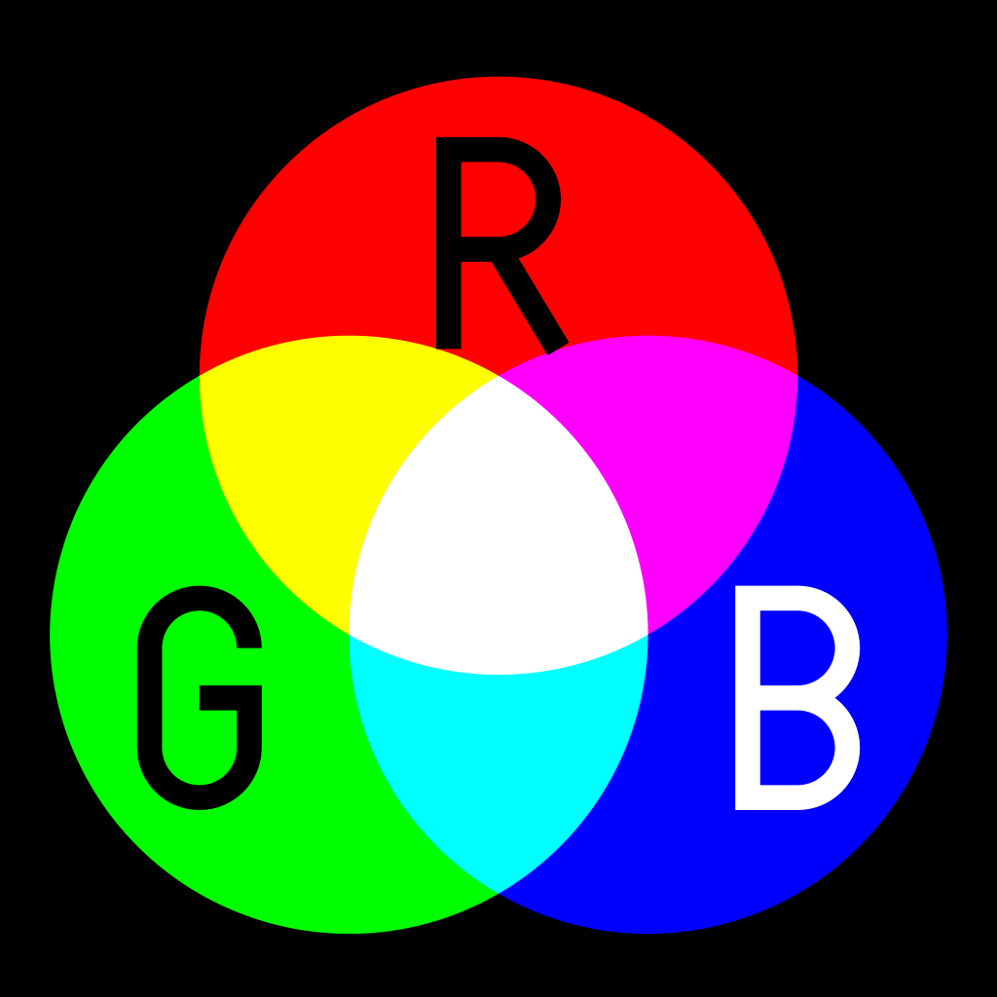
Primary Colors
Red (magenta), Blue (cyan) and yellow. These colors are the most basic colors and cannot be made by mixing other colors. All other colors are made by combining primary colors.

Slide 8

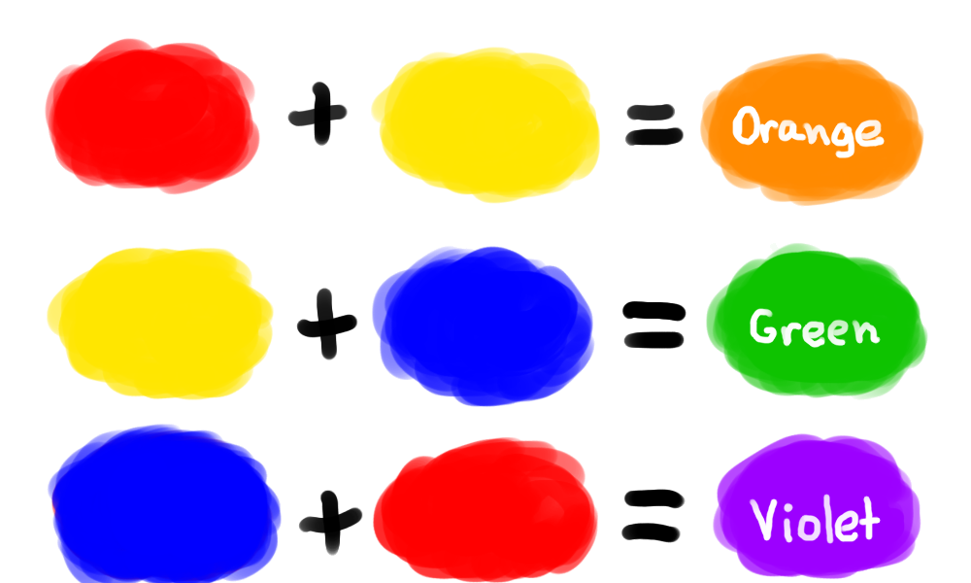
Secondary Colors
Orange, green and violet. These are made by mixing of the 2 primary colors:

Slide 9
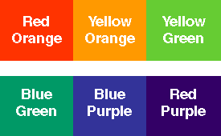
Intermediate (Tertiary) Colors
These colors are made by mixing a primary and secondary color. The primary color is listed first:

Slide 10
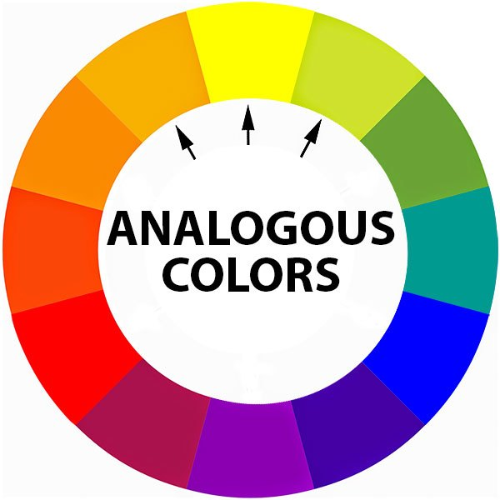
Analogous Colors
Colors which are next to each other on the color wheel

Slide 11
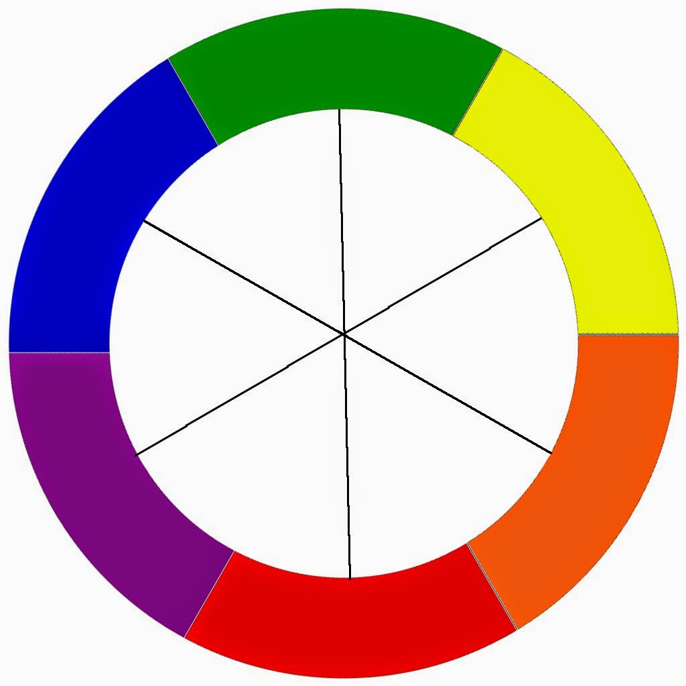
Complementary Colors
Colors which are opposite one another on the color wheel

Slide 12
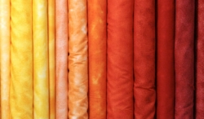
Warm Colors
Reds, oranges and yellows. They remind us of hot things (sun, fire) and intense emotions.

Slide 13
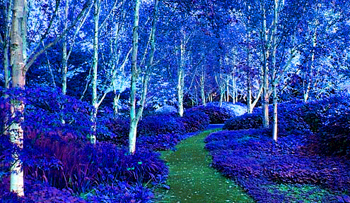
Cool Colors
Blues, greens and violets. They remind us of cool things (water, ice, cool, shady tree) and sad or peaceful emotions.

Slide 14
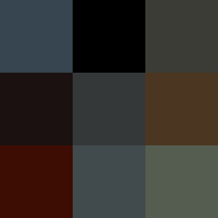
Neutral Colors
Colors not on the color wheel- ex- Tan, White, Black, Grey, Brown, etc.

Slide 15
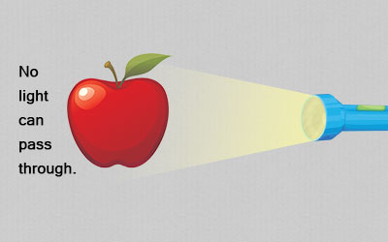
Opaque
Something that cannot be seen through such as a wall or tempera paint.

Slide 16
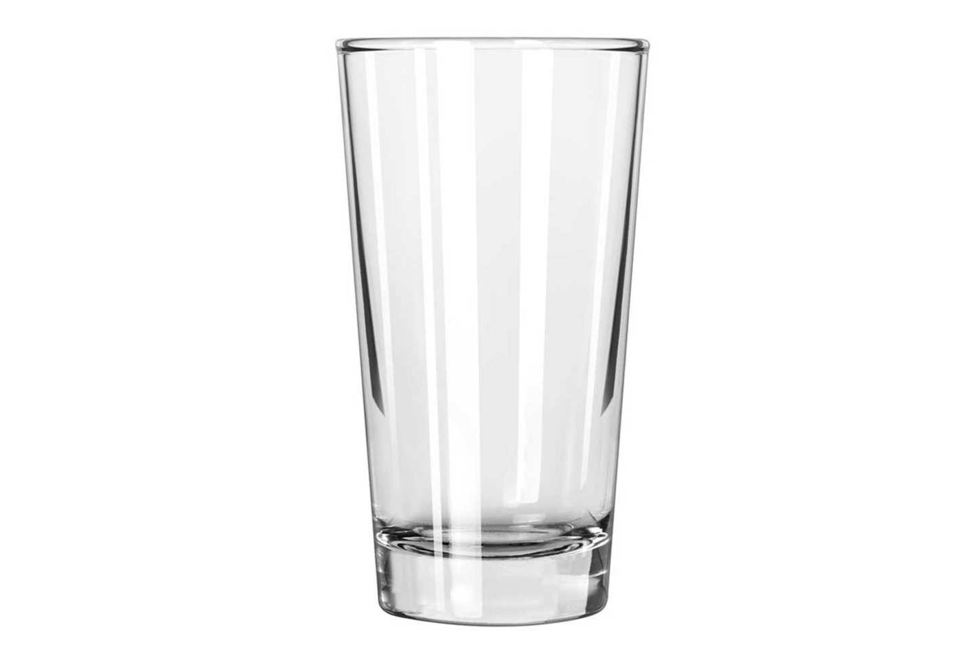
Transparent
Something that can be seen through such as glass or watercolor paint.

